Slide 1
IBM Capstone_Pizza Restaurants analysis

Slide 2
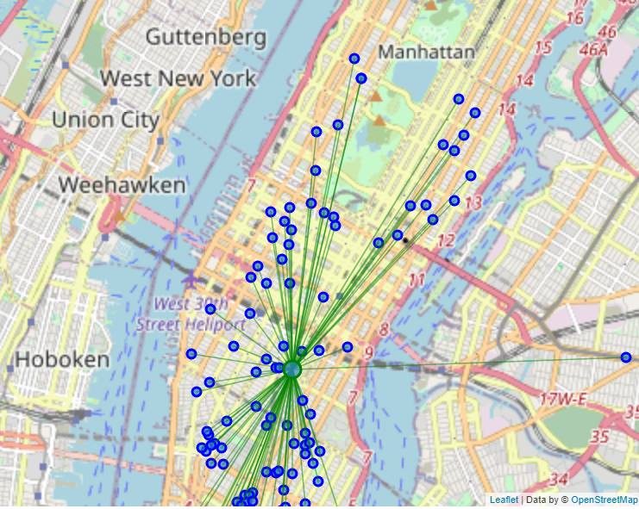
Checking the pizza density in the 5 cities using maps
New York

Slide 3
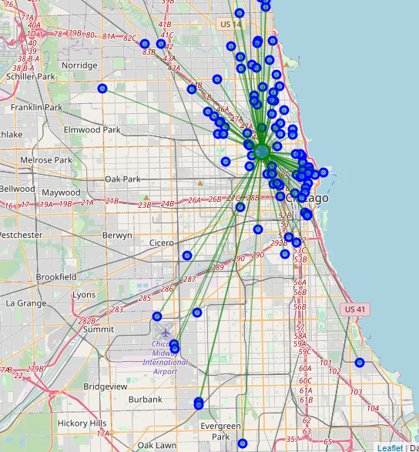
Checking the pizza density in the 5 cities using maps
Chicago

Slide 4
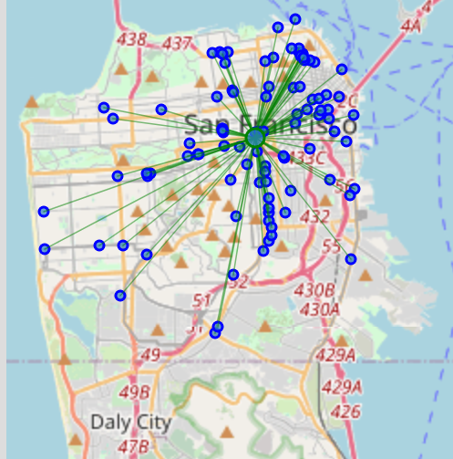
Checking the pizza density in the 5 cities using maps
San Francisco

Slide 5
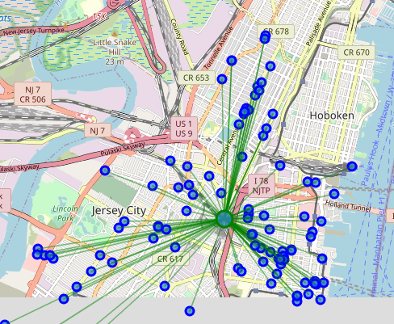
Checking the pizza density in the 5 cities using maps
Jersey City

Slide 6
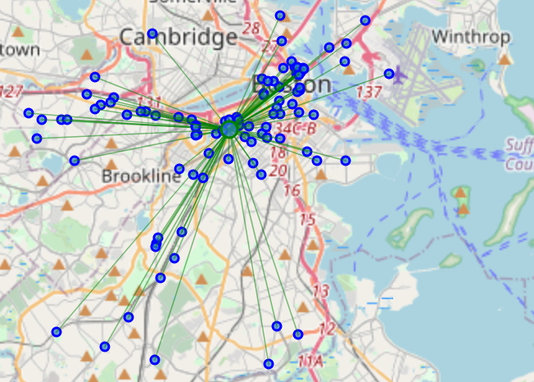
Checking the pizza density in the 5 cities using maps
Boston

Slide 7
The distances from the mean location
New York, NY
Mean Distance from Mean coordinates: 0.02355780980194641
Chicago, IL
Mean Distance from Mean coordinates: 0.05736433542465731
San Francisco, CA
Mean Distance from Mean coordinates: 0.028669570711800527
Jersey City, NJ
Mean Distance from Mean coordinates: 0.01936578522692453
Boston, MA
Mean Distance from Mean coordinates: 0.03590315981443015

Slide 8
Conclusion
It is clear that Jersey is the best option for a tourist to reserve his hotel near to the mean location and by that he will be surrounded by close 100 Pizza restaurants.

Slide 9
Thank you

